Slide 1
Wednesday, March 22
The Flipped Classroom and other innovative pedagogical approaches
Part A - Introduction, Background and Theory
Part B – Examples in practice and workshop with live curriculums
Jenny Hann, Quality Enhancement Directorate and Dr Imtiaz Khan, Cardiff School of Technologies

Slide 2
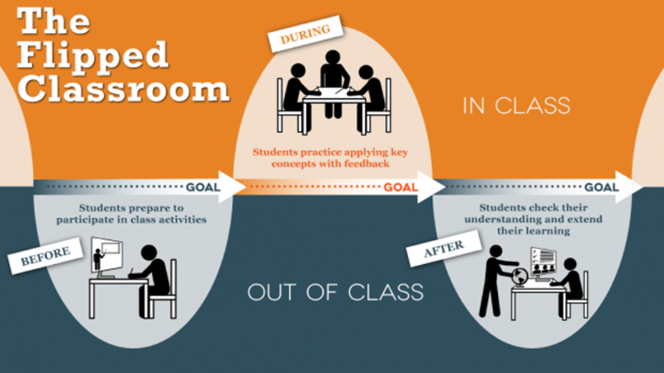
The Flipped Classroom
Flipped learning is a methodology that helps tutors to focus on active learning during contact time by assigning students lecture materials and presentations to be viewed at home (outside of school/ college or university.)
What do we mean by active learning?
Discussion
http://ctl.utexas.edu/teaching/flipping_a_class/what_is_flipped

Slide 3
Group Activity
Turn to the person next to you.
What does active learning mean to you?
Think of a scenario in which you learned something new?
Discuss that with your partner
What are the characteristics of active learning?

Slide 4
Active learning
Discussion
Padlet:
bit.ly/3Ldm6NV

Slide 5
Theory: Active learning
Active learning is an instructional approach in which students actively participate in the learning process, as opposed to sitting quietly and listening. Active learning builds on constructivist learning theory, which posits that people learn by connecting new ideas and experiences to what they already know.
Biggs, J., & Tang, C.

Slide 6
The Flipped Classroom
A flipped classroom is a type of blended learning where students are introduced to content at home and practice working through it when they are at school/college/university. This is the reverse of the more common practice of introducing new content at school, then assigning homework and projects to completed by the students independently at home.
What do we understand by the term blended learning?
What are the advantages of blended learning?
Is there a downside?
Discussion

Slide 7
Group Activity
Turn to the person next to you.
What does blended learning mean to you?
Discuss that with your partner?
What are the characteristics of blended learning?

Slide 8
Blended learning
Discussion
Refer to CMet 'definitions' document
Padlet:
bit.ly/429jXso

Slide 9
Theory: Blended learning
Blended Learning is not so much an innovation as it is a natural by-product of the digital domain creeping into physical spaces.
Broadly speaking, blended learning just means a mix of learning online and face-to-face, which means it’s likely your students are already doing some form of blended learning and have for years. As digital and social media become more and more prevalent in the life of learners, it was only a matter of time before learning became ‘blended’ by necessity.

