Slide 1




Constructive Alignment (what is it?)
Constructive Alignment, a term coined by John Biggs (Biggs, 1999) is one of the most influential ideas in UK higher education
It is the underpinning concept behind the current UK requirements for programme specification, declarations of Intended Learning Outcomes (ILOs) and assessment criteria, and the use of criterion based assessment
Learning and teaching activities relate directly to intended learning outcomes and assessment tasks (Biggs and Tang, 2011)

Slide 2
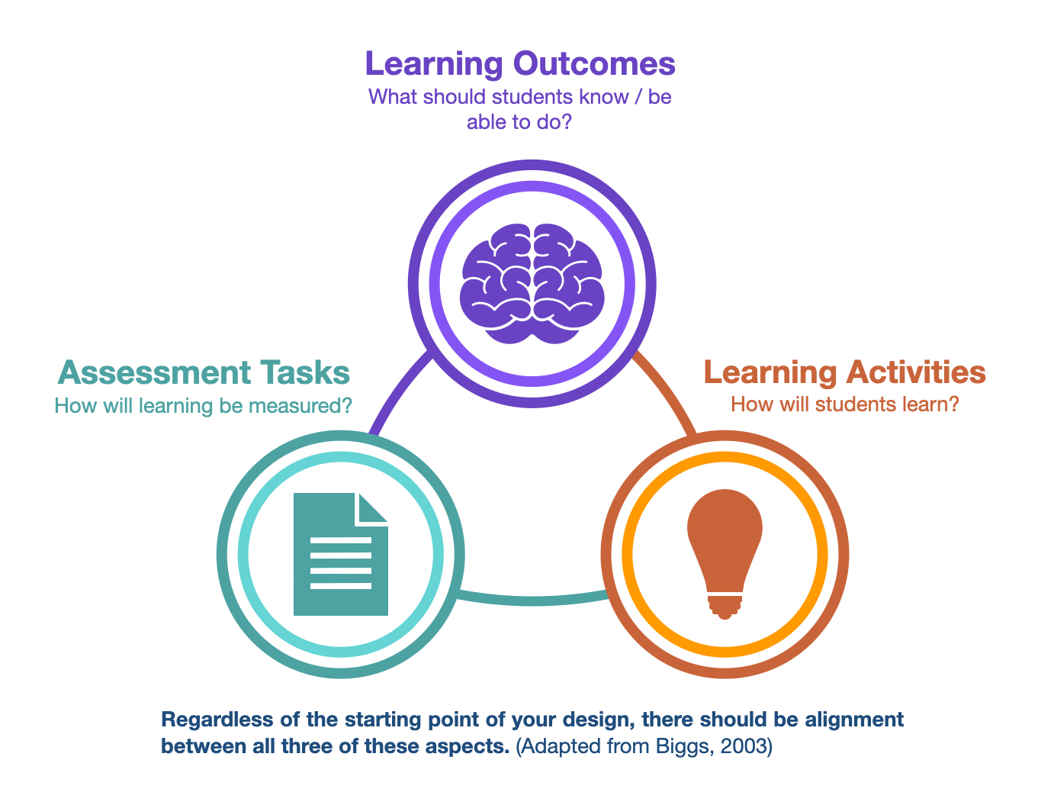
Constructive Alignment (what is it?)
The basic premise of the whole system is that the curriculum is designed so that the learning activities and assessment tasks are aligned with the learning outcomes that are intended in the programme.
This means that the system is consistent and systematic

Slide 3
Constructive Alignment (why to do it?)
If we have a clear idea of what we want students to be able to do at the end of a unit of study, we can communicate these intended learning outcomes to students so they can share in the responsibility of achieving them
We know that students will tend to look at the assessment and structure their learning activities, as far as they are able, to optimise their assessment performance
If we ensure that the assessment very obviously does test the learning outcomes we want students to achieve, then, by being strategic optimisers of their assessment performance, students will actually be working to achieve the intended learning outcomes

Slide 4
Constructive Alignment (why to do it?)
Consequently, the ILOs, the learning activities and the assessment should all be aligned. The assessment criteria should differ from the ILOs only in so far as that they might give more detail of performance levels required for specific marks
If we tell students that we want them to achieve something (ILOs) and then assess them against assessment criteria that do not match, they will feel cheated and will become cynical strategic surface learners
Alignment is really simply a matter of honesty and fairness that establishes the trust required for students to be confident that they can manage their own learning

Slide 5
Constructive Alignment (how to do it)
If we are taking a single component of a programme, we can 'Constructively Align' that by tackling the following steps:
Defining the learning outcomes with care and in line with guidance
Selecting learning and teaching activities likely to enable the students to attain the outcomes
Assessing the students' outcomes and grading the students learning using assessment criteria that is closely aligned with the learning outcomes
Constantly reflecting on practice and making changes to design and delivery (being a reflective practitioner)

Slide 6
Constructive Alignment (discussion time)
In breakout groups:
Thinking of a particularly successful teaching experience, what do you think made this so successful? Share this experience with others..
Following this, try to link the concepts of Constructive Alignment to the experience. Be prepared to feed back to the wider group.

Slide 7
Presentation Links
QAA Quality Code The Quality Code (qaa.ac.uk)
Framework for Higher Education Qualifications (FHEQ) https://www.qaa.ac.uk//en/quality-code/qualifications-frameworks
QAA Subject Benchmark Statements
https://www.qaa.ac.uk//en/quality-code/subject-benchmark-statements
Gaby Tobin
Head of Quality Enhancement
Additional References
Anderson, L.W., Krathwohl, D.R., Airasian, P.W., Cruickshank, K.A., Mayer, R.E., Pintrich, P.R., Raths, J., & Wittrock, M.C. (2001). A taxonomy for learning, teaching and assessing: A revision of Bloom’s Taxonomy of Education Objectives (Complete edition). New York: Longman.
Biggs, J, Aligning teaching for constructing learning, HE Academy (available at this link) https://www.advance-he.ac.uk/knowledge-hub/aligning-teaching-constructing-learning
Biggs, J., and Tang, C. (2011). Teaching for Quality Learning at University. Open University Press
Bloom, B.S. (1956). Taxonomy of Educational Objectives: The Classification of Education Goals. Longmans: London, W1.
Penney, D., Brooker, R., Hay, P., and Gillespie, L. (2009). Curriculum, pedagogy and assessment: three message systems of schooling and dimensions of quality physical education. Sport, Education & Society, 14(4), 421-422.
gtobin@cardiffmet.ac.uk

Slide 8



Introduction to
Constructive Alignment
Dr Joanna Hendy & Jenny Hann

Slide 9
Aims of this session
Explain the concept of constructive alignment
Identify the benefits of constructive alignment
Consider examples of how constructive alignment can enhance learning and teaching

Slide 10
Review these useful videos on Constructive Alignment
Short video about Constructive Alignment
Another short video about Constructive Alignment
Teaching Learning Activities
Intended Learning Outcomes
Assessment Feedback Tasks

Slide 11
Constructive Alignment: defining it
Constructive: Referring to the way in which students learn (i.e. constructivist learning philosophies)
Alignment: The role the teacher plays in structuring four key components of learning…
Defining Intended Learning Outcomes (ILOs)
Choosing activities that lead to the ILOs
Assessing students’ actual learning (cognitive and skill, surface or deep)
Arriving at a final grade for assessment

Slide 12
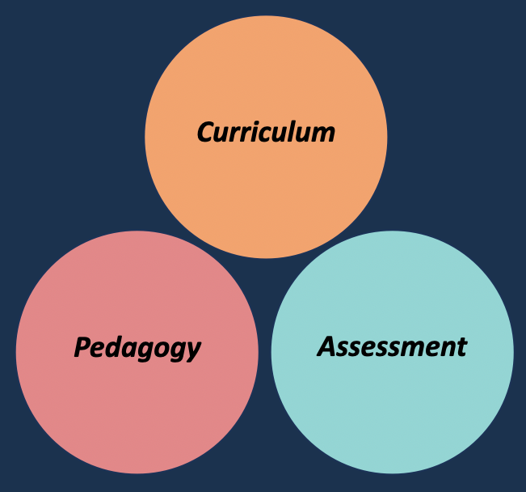
What is it?
Penney, D., Brooker, R., Hay, P., and Learning and teaching activities relate directly to intended learning outcomes and assessment tasks (Biggs and Tang, 2011);
The learner constructs their own learning through relevant activities;
The role of the teacher is to create a supportive learning environment with relevant learning activities;
Impacted by external influences such as grade descriptors, benchmark statements, regulatory bodies and other institutional drivers.
Penney, D., Brooker, R., Hay, P., and Gillespie, L. (2009). Curriculum, pedagogy and assessment: three message systems of schooling and dimensions of quality physical education. Sport, Education & Society. 14 (4), 421-422.

Slide 13
Interactive Task
Constructive Alignment: An example…
In groups of 4 or 5:
Thinking of a particularly successful teaching experience, what do you think made this so successful? Share this experience with others..
Following this, try to link the concepts of Constructive Alignment to the experience.

Slide 14
Constructive Alignment: Closing the loop
To plan effectively for any learning event, however small, we need to consider the core components:
Defining Intended Learning Outcomes (ILOs)
Choosing teaching and learning activities that lead to the achievement of the ILOs
Assessing students’ actual learning (cognitive and skill, surface or deep)
Arriving at a final grade for assessment

Slide 15
What is the impact of positive Constructive Alignment?
Surface learning: associated with acceptance, memorisation, and surface retention of information
Deep learning: associated with understanding, connecting concepts and critical analysis

Slide 16
Constructive Alignment: Interactive Task
Working in groups of 5
Take an existing module descriptor, teaching activities and assessment examples to ask the question:
Do the learning outcomes, assessment and teaching align to enable effective student learning? Is there scope for improvement?
How might the module be improved?

Slide 17
Constructive Alignment: Negotiating the Terms under Assessment
Can you define the following, and rank them:
Knowledge
Application
Evaluation
Comprehension
Synthesis
Analysis

Slide 18
Constructive Alignment: Negotiating the Terms under Assessment
Knowledge: evidence, the source material - Consider written material, numerical data
Application: of the evidence of your understanding - Consider processing content of existing knowledge
Evaluation: judgement of others’ work arguments - Consider strengths, weaknesses, drawing out a position
Comprehension: understanding and contextualising your evidence - Consider looking for patterns, messages
Synthesis: formulation of your own ideas based on others’ work - Consider conclusions, theories
Analysis: evidence of data, others’ evidence - Consider component parts, comparisons and contrasts

Slide 19
Constructive Alignment
Reflections on constructive alignment - what new idea, if any, will be your 'take away' from this session?

Slide 20


