Slide 1




Quality Assurance in the UK Context
Gaby Tobin, Head of Quality Enhancement
Notes:
I'm Gaby. I'm Head of Quality Enhancement at Cardiff Met. In essence this means I have oversight of how the University ensures the standards of its degrees and the quality of the student learning experience. I've been asked to speak to you today about how we ensure the quality of degrees in the UK. As you will know the project contains 2 training visits in Vietnam. The first (this one) focusing on the subject specific elements of UK and Vietnamese degrees and the second visit, in September, focusing more broadly on quality assurance. For this reason I will give an overview of the UK approach and some key concepts today before we move on, in Day 2 and 3 to the more subject specific elements of the project. The purpose being to allow you a broad understanding of how UK higher education functions and allow us (in discussion time) to understand how Vietnamese higher education functions, so that, as we head into day 2 and 3 we can put our discussion in context and recognise some key terms and concepts as they may arise in our workshops and discussions.

Slide 2
Aim of the Session
In this session we will outline some of the ways in which the level and content of degree programmes are assured in the UK. We will cover:
The UK quality context
Qualification descriptors
Subject benchmark statements
Programme aims and learning outcomes
Constructive alignment
Notes:
The British Council have requested that we cover, some key elements of the UK approach to higher education today and these are listed here. They include the UK quality context and then how we use key documents to ensure the standards of UK awards. The include what we call 'qualification descriptors' and 'subject benchmark statements'. In essence qualification descriptors tell us what type of knowledge and skills a student should develop at each level of a degree, subject benchmark statements tell us what type of content a degree should contain. So we will look at these key UK documents and discuss how we use them in the UK and what the Vietnamese approach to assuring the level and content of degrees is. We will consider the similarities and differences in our approach. Next we will take a break and then I will outline how, in the UK, we approach writing programme aims and learning outcomes and a key element of UK higher education we can 'constructive alignment'. I will unpack this concept in the session and again we will discuss and consider the similarities and differences in the UK and Vietnamese approach.

Slide 3
Who Oversees Quality of UK Higher Education?​
The Quality Assurance Agency (QAA) is the UK-wide independent body which safeguards quality and standards in UK Universities ​
The QAA reviews UK higher education wherever it is offered (i.e. including all UK provision offered in the UK and overseas).​
See www.qaa.ac.uk for more information
Notes:
I'll open with an overview of how we oversee quality assurance in the UK. Universities in the UK are autonomous institutions, meaning, we draw down funding from the government and need to give assurances on how we deliver programmes, but the decisions about what we teach and how we teach it are left to us to determine as an institution. One of the challenges of this approach, and not having a national curriculum, is how to ensure the parity of approach in different Universities if we are all teaching different syllabuses. This is where the Quality Assurance Agency comes in. They are a UK wide independent body, commissioned by the UK government to safeguard standards and quality in UK Higher Education. The review UK higher education wherever it is delivered across the world including UK degrees offered overseas. In the Cardiff Met context this means the QAA inspect our degrees in Cardiff but also at our many overseas partner Universities. Cardiff Met has approximately 13 partners based all over the world delivering Cardiff Met degrees and they all are subject to QAA oversight and inspection.

Slide 4
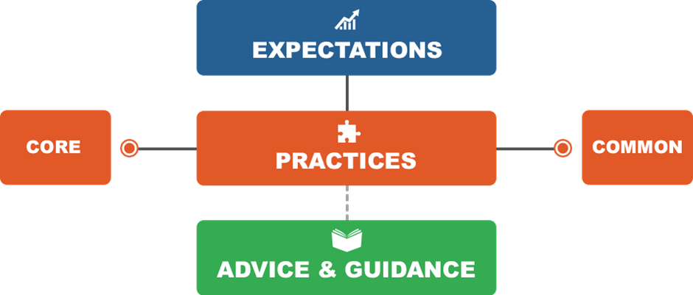
The UK Quality Code for Higher Education
The Quality Code is the key reference point for UK Higher Education​
It protects the public and student interests ​
It champions UK Higher Education’s world-leading reputation for quality. ​
It enables Higher Education providers to understand what is expected
Notes:
One of the key ways in which the QAA supports UK Universities to keep high standards and quality is through its Quality Code. This is a key reference point for all UK Universities and their partners. It sets out what is expected of a University, what practices a University should follow and it has a range of advice and guidance to help Universities understand how to meet the expectations. The advice and guidance into themes such as 'course design and development' or 'partnerships' or 'assessment'. The advice ad guidance has been written by a collective of colleagues from all across the UK who teach on, design, or oversee UK higher education and is routinely updated. Through ensuring UK Universities align with the Quality Code students, parents, government bodies and other stakeholders can be assured of a shared approach to standards and quality in UK Universities and their partners. I'm going to now show you a short 3 minute video from the QAA that further explains the various elements of the code.

Slide 5
Qualification Descriptors
Public confidence in academic standards requires public understanding of the achievements represented by higher education qualifications and how the standards are secured
The QAA publishes a set of Frameworks for Higher Education Qualifications (FHEQ) which described the different levels and requirements for each of these
The FHEQ is supported by qualification frameworks, credit arrangements, subject benchmark statements and guidance on qualification characteristics
Notes:
As noted earlier along with the advice and guidance within the Quality Code there are 2 other key documents which the QAA oversee which help UK Universities, and their partners, ensure the quality and standards of their degrees. The first of these are what we call 'qualification descriptors'. In the UK we define a different types of awards as 'qualifications' these qualifications include 'Bachelors Degrees', 'Masters Degrees' and 'Research Degrees'. Each qualification (or degree) sits at a difference level and the qualification descriptor explain what is expected at each level. The official title of the document in which the qualification descriptors are held in the Framework for Higher Education Qualifications and we tend to call it the FHEQ. The FHEQ helps universities to assure students, partners, employers and other stakeholders that the level of learning a student has demonstrated to pass a degree is at the expected level.

Slide 6
Qualification Descriptors cont.
The FHEQ sets out the different levels at which qualifications are set in the UK
The levels within UK Higher Education are at 4 to 8
Bachelors Degrees include study at levels 4, 5 and 6. Masters Degrees are studied at level 7 and Doctoral Degrees at level 8
The FHEQ sets out for each qualification: what students need to have demonstrated, what they will typically be able to do, and what qualities and transferable skills they will have
Notes:
As I noted UK qualifications are designed in 'levels' and the FHEQ sets out what these levels are and to which level each degree aligns. Bachelors Degrees, for example are normally 3 years long and cover 3 levels of learning, level 4, 5 and 6. Students need to have demonstrated the knowledge and skills at each level to move to the next and to have demonstrated learning at level 6 to be able to graduate with a Bachelors Degree. We, as lecturers and quality staff, ensure this by designing our learning and teaching approaches and our assessments at the appropriate level and the qualification descriptors help us to understand how to do this. In most UK Universities the use of qualification descriptors is embedded in our processes and procedures so that when lecturers are designing programmes or are teaching they will automatically align their approach with the right level and we have a range of checks and balances in place to ensure this is the case.

Slide 7
Subject Benchmark Statements
Subject Benchmark Statements describe the nature of study and the academic standards expected of graduates in specific subject areas.
They show what graduates might reasonably be expected to know, do and understand at the end of their studies
Subject Benchmark Statements are written by subject specialists and the QAA facilitate this process
Notes:
So the qualification descriptors tell us how to design our degrees at the right level but how, in the UK, do we decide what the content of a degree should be? What makes one degree a computing degree and another a medicine degree? How can we ensure that we are delivering the right stuff in our degrees, the skills and knowledge that students need in order to be able to enter the workforce and meet the needs of employers? This is where our Subject Benchmark Statements come in. They are designed by subject (for example there is one for computing that I will show you in a moment) and they outlines the nature of study in that subject areas and what graduates in, for example, a computing degree, should be able to do on graduation. They are not written by the QAA. The QAA oversee them and facilitate their development and upkeep but the content is determined by academics in the subject area from across the whole of the UK. On a rolling basis the QAA will do a call out to all UK Universities and ask for volunteers from the subject area to join a group from across the UK to decide, for example, 'what should a computing degree contain? What is important in a computing degree? What standards and areas of study should a computing degree contain?'. The output of this work then is published by the QAA and used in a number of ways by UK Universities.

Slide 8
Subject Benchmark Statements cont.
They are used as reference points in the design, delivery and review of academic programmes
They provide general guidance but are not intended to represent a national curriculum or to prescribe set approaches. Instead, they allow for flexibility and innovation
Notes:
Some of the ways that they are used are, for example, in the design of new degrees, in the review of existing degrees (to keep them up to date) and in the day-to-day delivery of learning and teaching. We ensure this through asking teams during programme approval and review to demonstrate alignment through a mapping exercise and we ask our external examiners to confirm ongoing alignment on an annual basis.
The statements provide guidance and a broad description of degree content but allow some flexibility so that Universities can design degrees that can respond to sector innovation and local contexts as needed.

Slide 9
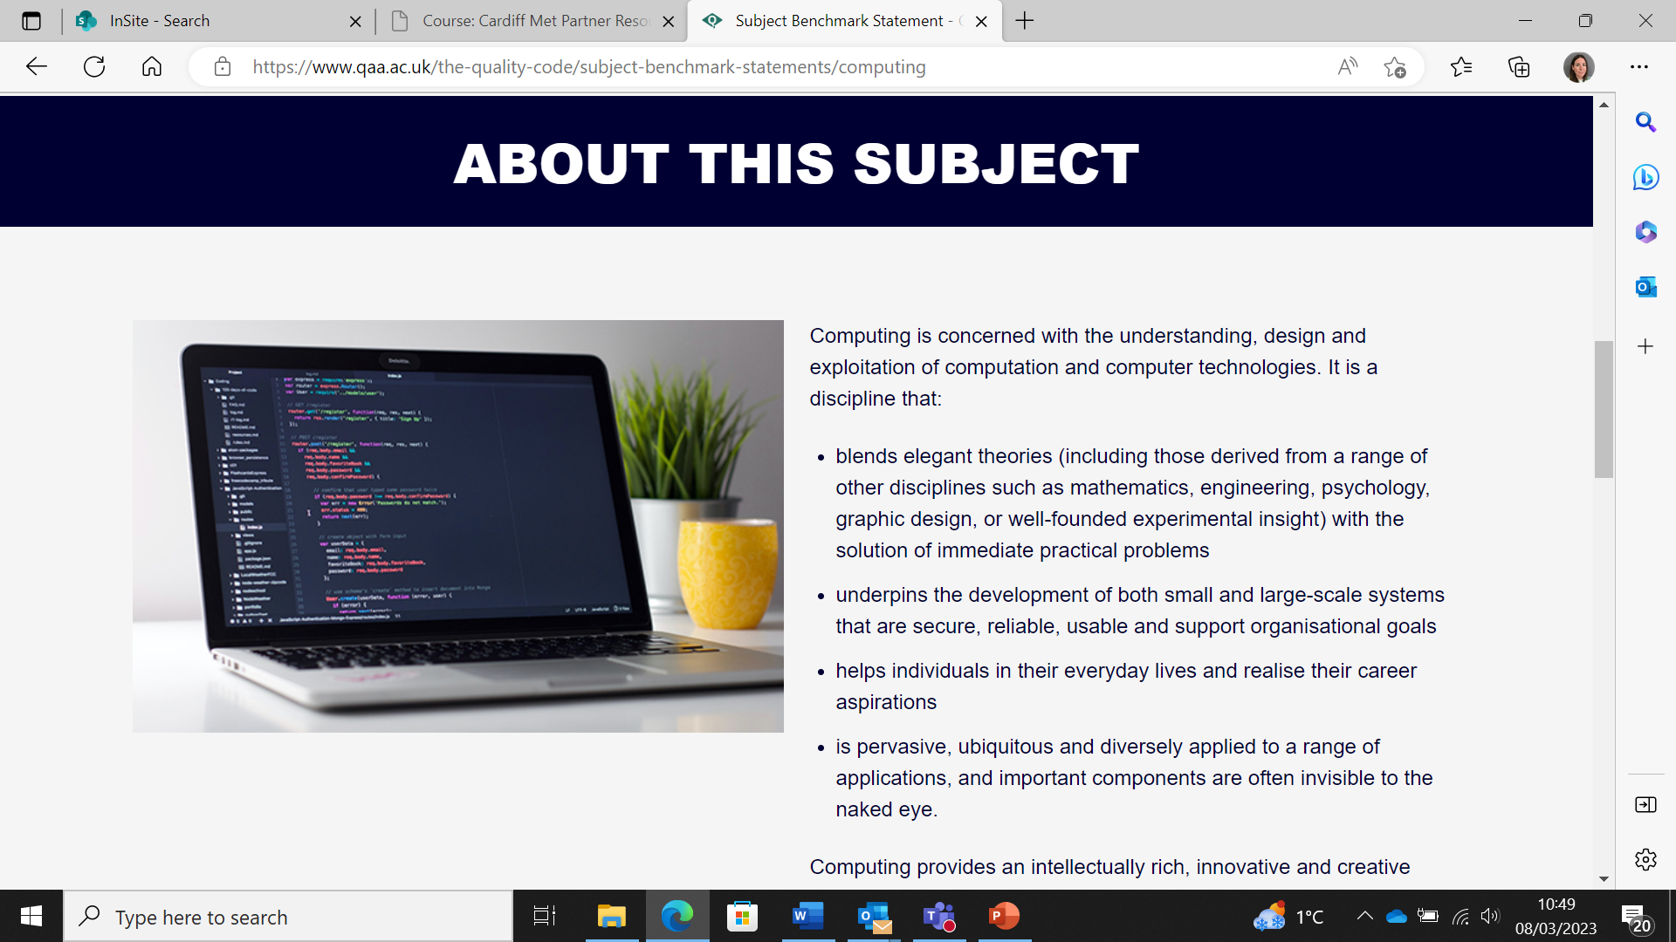
Subject Benchmark Statements cont.
Notes:
I'm just going to quickly show you the subject benchmark statement for computing to give you a sense of what it contains and then we will take a quick break and then form groups to discuss qualification descriptors and subject benchmark statements and the Vietnamese equivalents.

Slide 10
Qualification Descriptors and Subject Benchmarks (discussion time)
In breakout groups:
UK colleagues discuss how you use the qualification descriptors and subject benchmarks in your programme design and delivery. Vietnamese colleagues discuss how programme levels and subject content is determined in the Vietnamese context.
Following this, try to determine what the differences and similarities of the approaches are. Be prepared to feed back to the wider group.

Slide 11
Presentation Links
QAA Quality Code The Quality Code (qaa.ac.uk)
Framework for Higher Education Qualifications (FHEQ) https://www.qaa.ac.uk//en/quality-code/qualifications-frameworks
QAA Subject Benchmark Statements
https://www.qaa.ac.uk//en/quality-code/subject-benchmark-statements
Gaby Tobin
Head of Quality Enhancement
Additional References
Anderson, L.W., Krathwohl, D.R., Airasian, P.W., Cruickshank, K.A., Mayer, R.E., Pintrich, P.R., Raths, J., & Wittrock, M.C. (2001). A taxonomy for learning, teaching and assessing: A revision of Bloom’s Taxonomy of Education Objectives (Complete edition). New York: Longman.
Biggs, J, Aligning teaching for constructing learning, HE Academy (available at this link) https://www.advance-he.ac.uk/knowledge-hub/aligning-teaching-constructing-learning
Biggs, J., and Tang, C. (2011). Teaching for Quality Learning at University. Open University Press
Bloom, B.S. (1956). Taxonomy of Educational Objectives: The Classification of Education Goals. Longmans: London, W1.
Penney, D., Brooker, R., Hay, P., and Gillespie, L. (2009). Curriculum, pedagogy and assessment: three message systems of schooling and dimensions of quality physical education. Sport, Education & Society, 14(4), 421-422.
gtobin@cardiffmet.ac.uk

Slide 12



Quality Context
(frameworks, benchmarks, quality systems and international recognition)

Slide 13
Today’s Sessions Will Focus On:
UK, Vietnamese and ASEAN region qualification frameworks and benchmarks (including QAA and AUN alignment)
Robust quality assurance systems
Achieving international recognition of qualifications

Slide 14
We will follow the following format for the day:
For each of the three areas being covered we will:
have a brief recap of the context (approx. 15 minutes, including time for questions)
Undertake a learning activity
Re-group and reflect on the activity

Slide 15
Frameworks and Benchmarks:
In your pre-reading for this session you would have considered the UK, Vietnamese and ASEAN region qualification frameworks.
The following is a short recap of the key elements of each system. Following which we will undertake an activity to consider the alignment and differences in each region.

Slide 16

UK Framework for Higher Education Qualifications and Subject Benchmark Statements
Overseen by the Quality Assurance Agency
Framework for Higher Education Qualifications (FHEQ)
Subject Benchmark Statements
The FHEQ outlines what students need to have demonstrated, what they will typically be able to do, and what qualities and transferable skills they will have.

Slide 17

ASEAN Framework and Benchmarks
The countries work together in a range of areas, including on initiatives to enhance comparability of qualifications and the mobility of students.
ASEAN Qualification Reference Framework (AQRF)
ASEAN Quality Assurance Framework (AQAF)
The AQRF enables comparison of qualifications and provides a common spine of levels to which all NQFs relate

Slide 18

Vietnamese Framework and Benchmarks
Higher Education in Vietnam is overseen by The Ministry of Education and Training (MOET)
The Vietnamese Qualifications Framework outlines the learning outcomes expected at each level including Knowledge and Understanding, Skills, and Autonomy and Responsibility

Slide 19
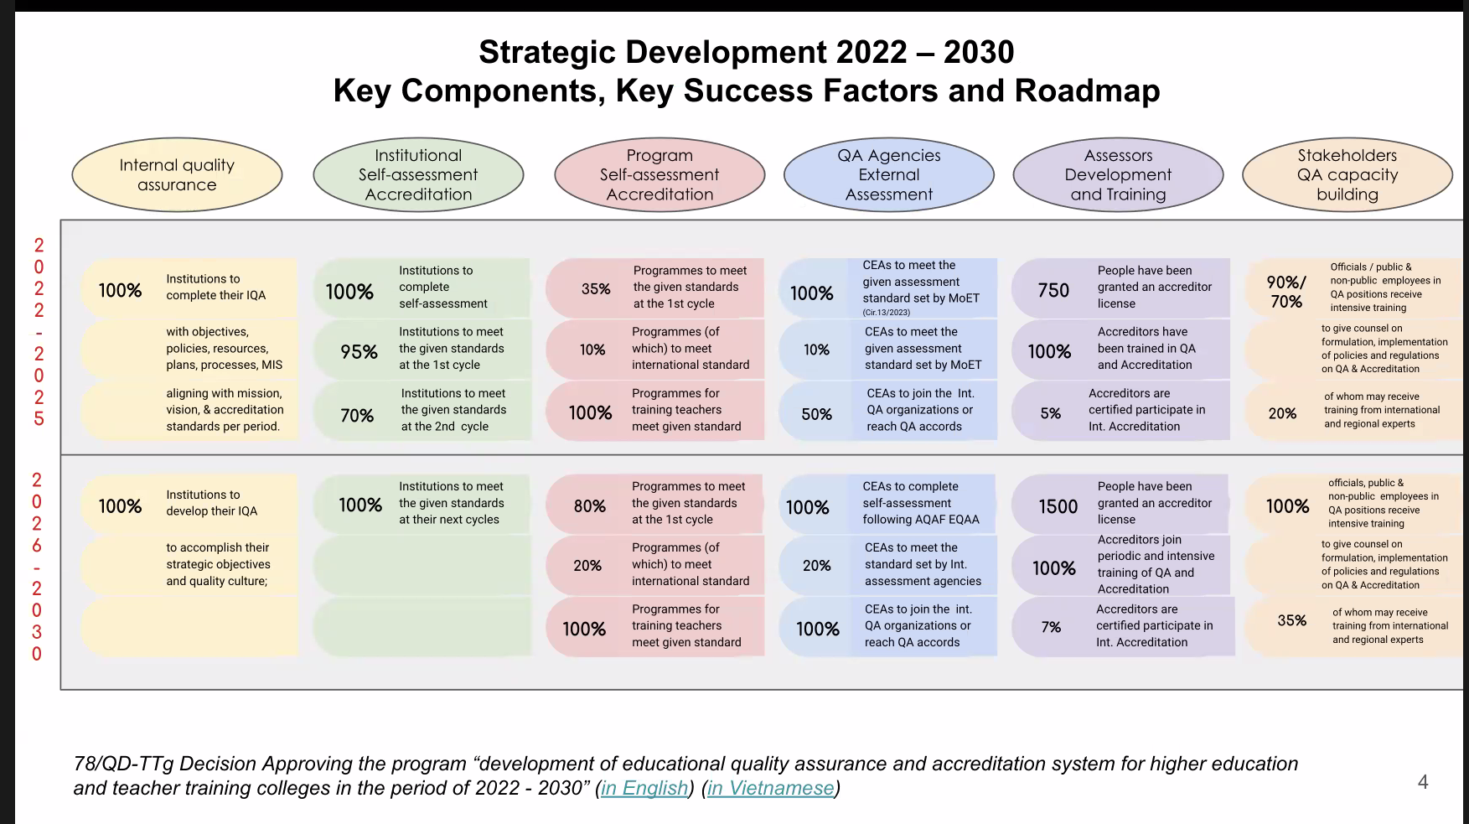
Source:
2023 Annual QAA conference (14/09/2023) session presented by Ms Tran Bich Hue (MOET)

Slide 20
Learning Activity 1
1. On your table you will find a set of cards. Each card includes a key element from a framework or benchmark from a region.
2. Put the right cards in the right columns
3. Once all cards are placed discuss in your group:
why you placed each element in each region
the similarities and differences between each column
4. Be ready to share your thoughts with the room.

